Slide 1

Welcome to Cornell!
Comments to Mandela Washington Fellows at Cornell and Syracuse University
Chris Barrett
Dyson School of Applied Economics & Management
Brooks School of Public Policy

Slide 2


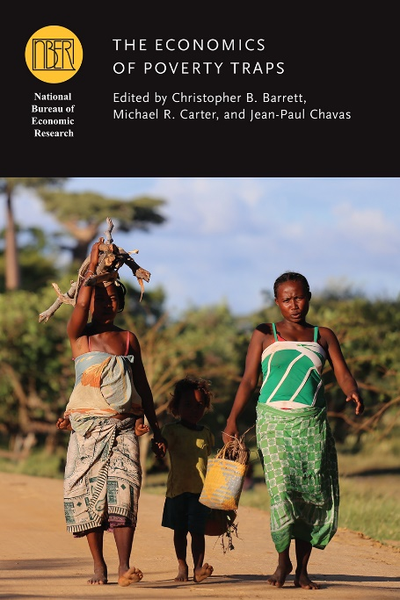
Core motivation
My core professional goal:
Use economics research, outreach, teaching and mentoring to reduce unnecessary human suffering

Slide 3
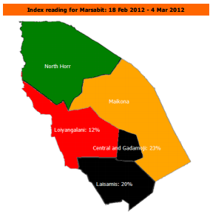

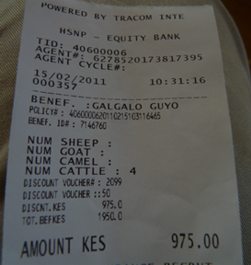
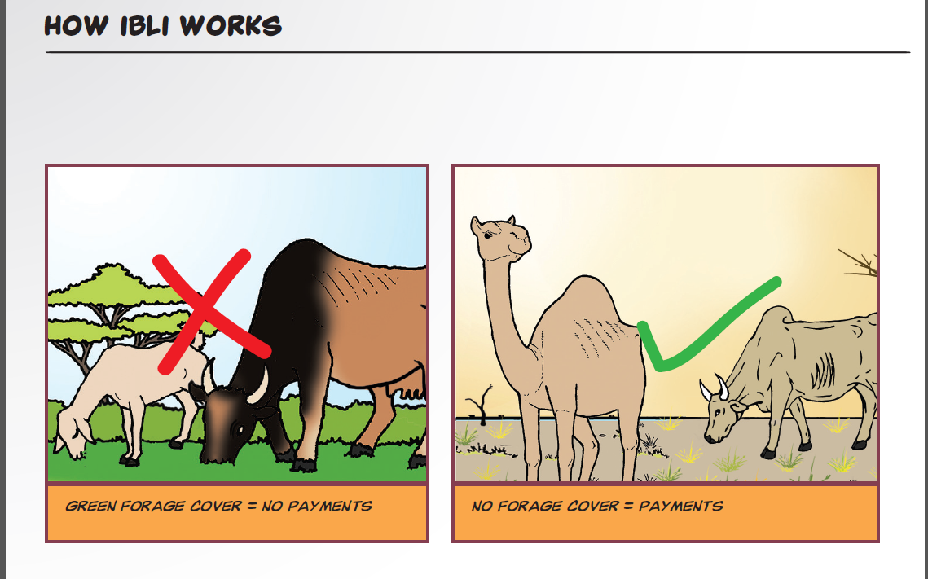
Some specific applications
Index-based livestock insurance (IBLI) in Kenya, Ethiopia, and now Zambia, Mauritania, soon in Djibouti, Somalia, Sudan

Slide 4

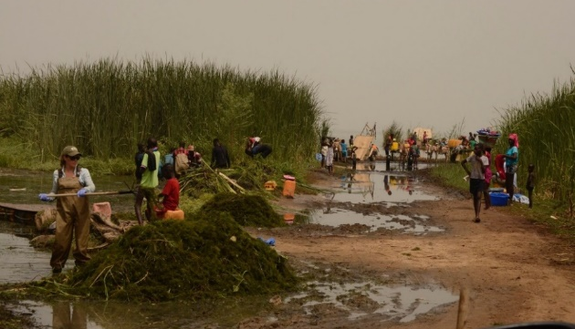
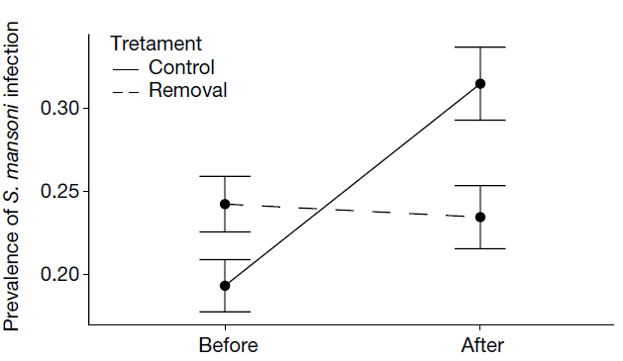
Some specific applications
Integrating schistosomiasis control and agricultural development in Senegal

Slide 5
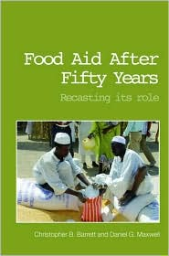
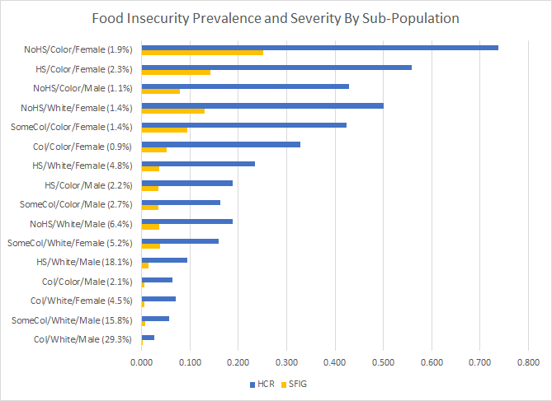
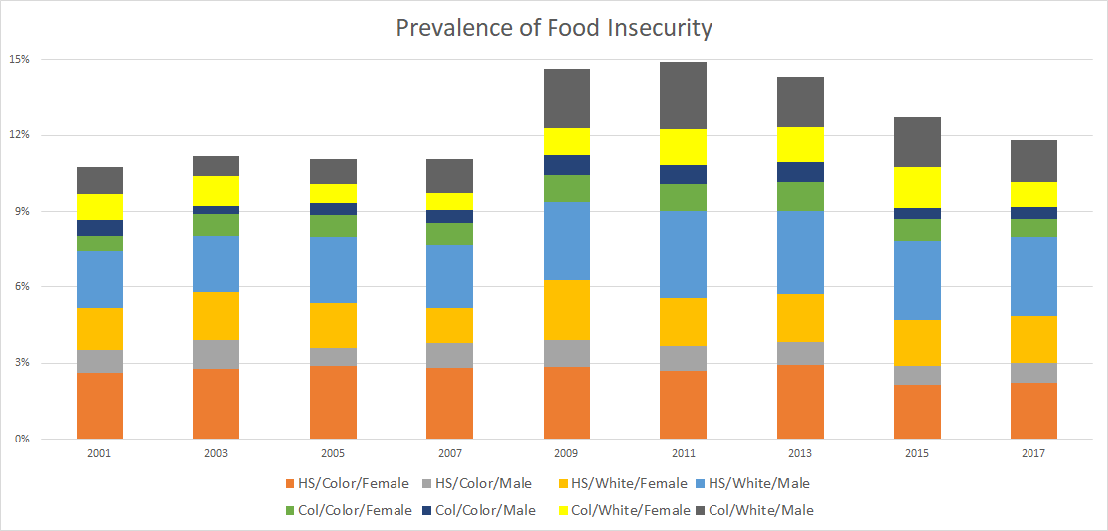
Some specific applications
Food security and food assistance policies

Slide 6
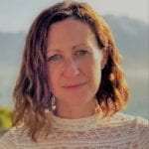
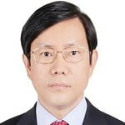
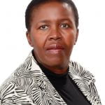
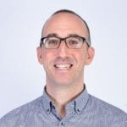
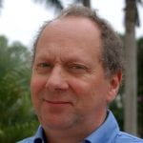
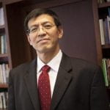
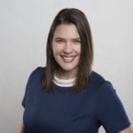
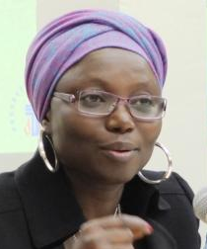
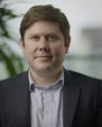
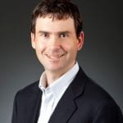
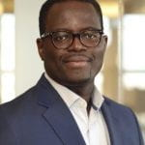
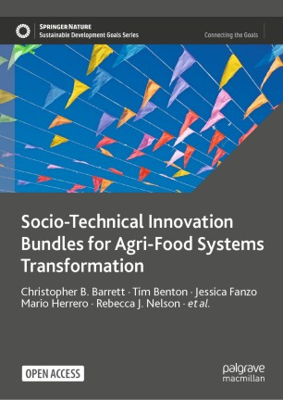
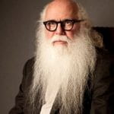
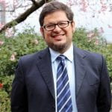
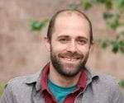
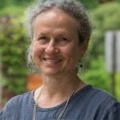
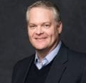
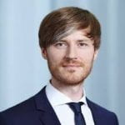
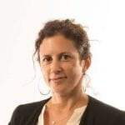
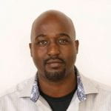
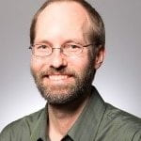

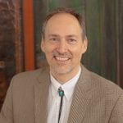
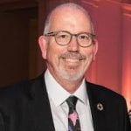
Some specific applications
Cornell Atkinson – Nature Sustainability 2020 expert panel on “Innovations to Build Sustainable, Equitable, Inclusive Food Value Chains,” a diverse group of 23 experts from across disciplines, regions, organizations, etc., w/10 additional co-authors.
2022 open access book … and now FAO ATIO
Based on the”, released Dec. 2020.

Slide 7
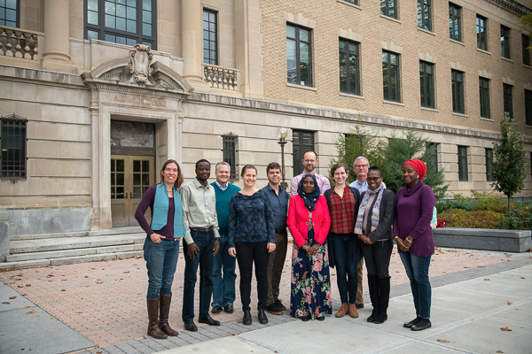
STAARS
The Structural Transformation of African Agriculture and Rural Spaces (STAARS) Fellows program
here at Cornell aims to help early career African economics researchers advance similar research objectives/impacts.
Thank you for your time and interest.
Enjoy your visit to Cornell!

